Slide 1


Urban Kitchen
A B2B Startup in Restaurant Industry
With
A Restaurant Management Portal

Slide 2
ABOUT
Urban Kitchen is a B2B startup in restaurant industry that helps restaurant owners/managers to manage staff and customers and analyze their business performance developing management portals and analytical dashboards
PROBLEM STATEMENT
Urban Kitchen is building a software to help restaurant managers/owners to optimize the bandwidth of the waiting staff through table management portal and analyze their business performance through analytical dashboards. Have to come up with
Logic for assigning staff in real time to the tables
Wireframes for table management portals and analytics dashboards
Monetisation model for developed product
GOALS
Suggest a suitable algorithm of assigning Y waiters to X tables
Provide performance metrics of their staff, customers and business and visualize through graphs and charts
Revenue model for UK’s product

Slide 3
WHY MANAGEMENT PORTAL?
CUSTOMER PAINPOINTS
Restaurant managers(RMs) manage their staff, maintain customer satisfaction and keep track of thousand others at a time to run a successful restaurant, and end up unanswering ‘How my business is doing?’
ROs also unable know the staff performance in the whole month/year
Unable to decide what to improve to increase the revenue, optimize waiting staff, cutdown expenses, etc.
UK SOLUTIONS
A table management portal that automatically assigns a waiter to a customer filled table
Time per table turnaround calculator(a KPI for revenue and customer satisfaction)
Analytics of sales and expenses data, feedback of customer satisfaction, staff performance, effectiveness of menu items/specials
CUSTOMER NEEDS
A software which automatically assigns a filled customer table to one of the waiting staff
Creating and calculating KPIs affecting revenue
An analysis measuring staff performance and customer satisfaction

Slide 4
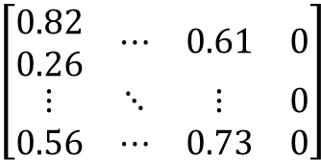

ASSIGNING X TABLES TO Y WAITERS (KM_{B} Algorithm)
At any given point of time, ‘p’ tables are occupied ‘q’ waiters are assigned, then (X-p) tables are remained, (Y-q) waiters are remained, then in real time ‘m’ tables to be assigned to ‘n’ waiters(where m = X-p; n = Y-q)
PREPARATION STAGE
Table Range Vector (L):
A vector representing minimum number of waiters required for each table
2. Ability Limit Vector (Lª):
A vector representing maximum number of tables that can be handled by a single waiter
L → [1 2 1 3 ………. 2]_{1xn}
Lª → [2 1 3 1 ………. 1]_{1xm}
3. Performance Matrix (Q):
A matrix where each element represents performance of a waiter of that table.
The value is calculated using linear combination of number of times a table served, a score of efficiency handling a small or big table.
An elemental value is (1 – value derived), since algorithm runs as minimum effective matching
4. Expanded Matrix (M):
Expand ‘Q’ matrix into K x K matrix where waiter’s vector has ‘L^{a’} number of rows and table’s vector has ‘L’ number of columns (Fill zeros for new columns of M, such that M is a K x K matrix )
1 2 …………………… k
*Assuming (m > n)
And k = m (in this case)
12……k
$$\left[\begin{matrix}\begin{aligned}0.82 \\ 0.26\end{aligned} & ⋯ & 0.61 & 0 \\ ⋮ & ⋱ & ⋮ & 0 \\ 0.56 & ⋯ & 0.73 & 0\end{matrix}\right]$$
1 2 ……….. n
12……m
$$\left[\begin{matrix}\begin{aligned}0.82 \\ 0.26\end{aligned} & ⋯ & 0.61 \\ ⋮ & ⋱ & ⋮ \\ 0.56 & ⋯ & 0.73\end{matrix}\right]$$
M_{kxk} =
Q_{mxn} =
Ref : KM_{B} Algorithm

Slide 5
Processing Stage(Logic) :
Find the smallest element and subtract it from every element in its row and also find smallest element in every column and subtract it from other element
Initial Stars: find a zero (Z) in M. If there is no starred zero in its row or column, star Z, and adjust zeros to be unavailable, which belong to the same agent but in different rows or columns.
Starred zero in row containing primed zero?
Cover each column containing a starred zero
All covered?
Not covered?
Prime some uncovered zeros: find an uncovered zero and prime it, and adjust zeros to be unavailable, which belong to the same agent but in different rows or columns (starred zeros are excluded)
Until no uncovered zeros are left
Until no starred zero in row containing primed zero
Cover this row and uncover column containing the starred zero
Construct a series of alternating primed and starred zeros as follows
Unstar each starred zero of the series, star each primed zero of the series, erase all primes, and uncover every line in M
Backtracking: adjust unavailable elements to be available according to the erased starred and primed zeros in M
Without altering any stars, primes, or covered lines
Z₀ | Z₁ | Z₂
Uncovered prime zero | Starred zero in column of Z₀ | Primed zero in row of Z₁(there will be always one)
No uncovered zeroes left ?
Save smallest uncovered value
Add the value found in Step 4 to every element of each covered row, and subtract it from every element of each uncovered column
The required assignments are indicated by the positions of the starred zeros in M. If M[i, j] is a starred zero, then the element associated with row is assigned to the element associated with column j. (End of KMB)

Slide 6
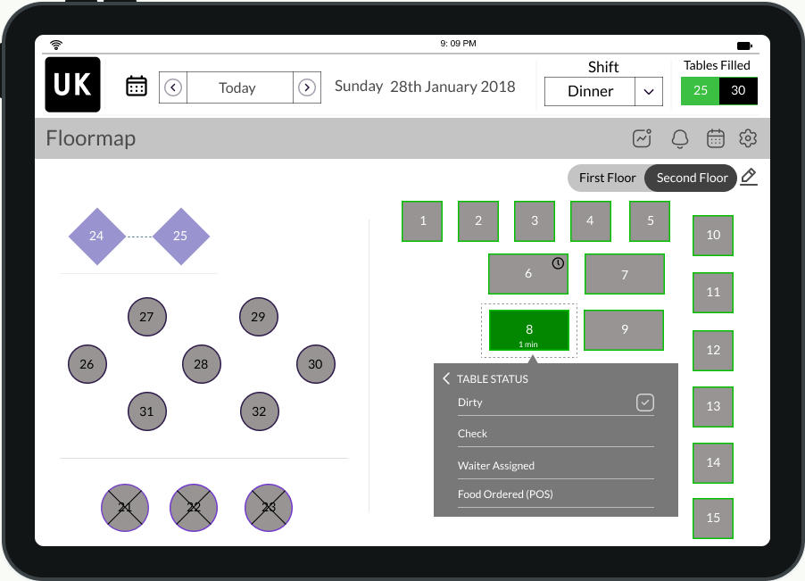
TABLE MANAGEMENT PORTAL
Table Timer
This one calculates our required Time per Table Turnaround
Merge Tables
Merge multiple tables together for large parties. Move seated parties between tables as needed, without losing party information
Block Tables
Block tables off for special events, or let the rest of the team know they have been reserved
Table Status Indicator
This can be used to track table state(check dropped, waiter assigned, needs to be cleared, etc.)

Slide 7
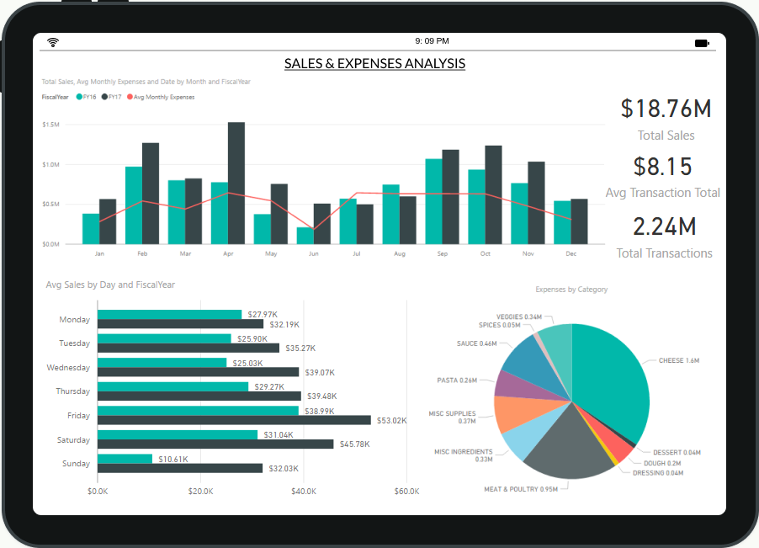
SALES & EXPENSES DASHBOARD

Slide 8
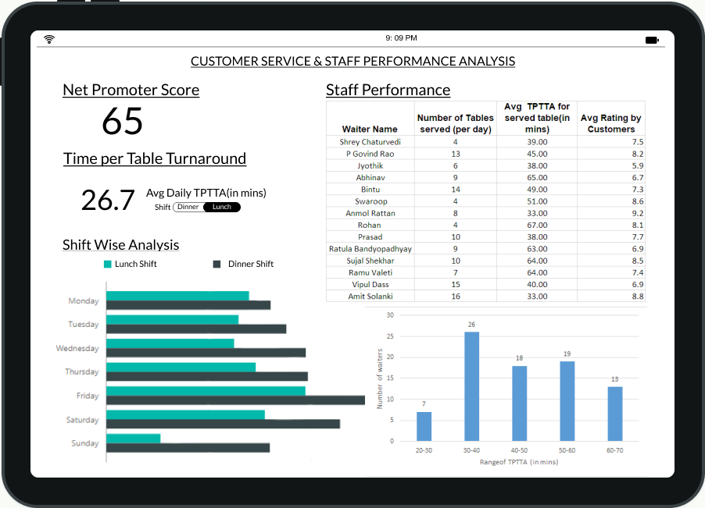
CUSTOMER SERVICE & STAFF PERFORMANCE DASHBOARD

Slide 9
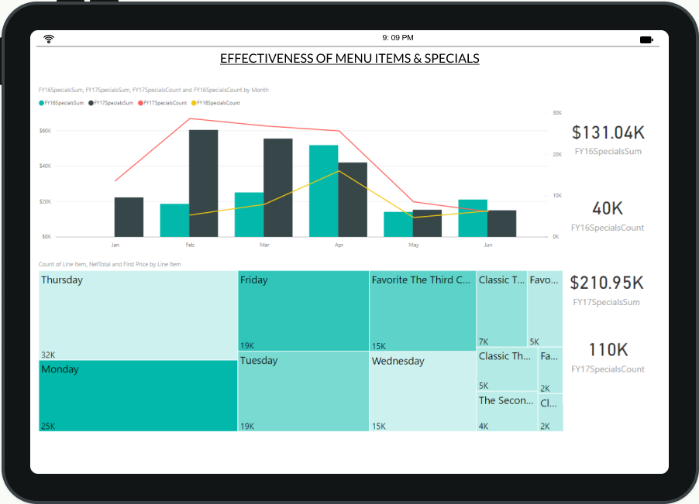
MENU ITEMS & SPECIALS ANALYSIS DASHBOARD

Slide 10
PRODUCT MONETIZATION
A basic price( Rs. X ) would be charged for buying a software having table management portal and basic analytics dashboard, editing floor map, etc.
Floor based charges
The extra basic price to be incurred based on number of floors since algorithm, software run time has to be faster since there would be large database and lot many queries would be running behind. Based on that:
If number of floors < 2 → Rs. X
If number of floors >2 → Rs. 1.7X (Based on clear assumption created these numbers)
Extra charges for extra-premium features
Integrating social media channels to analytics
Providing analysis of restaurant’s social media posts, customer’s interactions, daily impressions, etc.
Integrating these features to analytics would help restaurant managers what customers think of their restaurant

Slide 11
Thank you!
Alsatwar Sravan Kumar
Pre-final year student, IIT(ISM) Dhanbad

